Slide 1

ETHEREUM TRANSACTION FRAUD FLAGGING
Ashwin Krishnan (MSC-C.S. Computer science sies Nerul)

Slide 2
ETHEREUM & CRYPTO-CURRENCY
Cryptocurrency is a type of digital currency that operates independently of a central bank or government. It utilizes blockchain technology, which is a decentralized ledger that records transactions across a network of computers
Ethereum is unique because it allows developers to create decentralized applications (Dapps) on its blockchain.
Ethereum has its own cryptocurrency called Ether (ETH), which is used to pay for transactions and to incentivize miners to secure the network

Slide 3
Pipeline workflow
Transaction Between Two Parties
Fraud Flagging
Redis Storage
Stream append log
Disjointed Model Retuning
Model Retuning & Assessment (Self Defined Time Period)

Slide 4
CICD - Redis Streams & Fraud FLAGGING
The Project uses a Continuous Integration & Continuous Deployment Approach where the fraud detection model is served using an API and can be retrained on the fly resulting in no down time.
The transactions are stored with the risk flag in an append only log data structure provided by Redis known as Redis-Streams.
The fraud detection model uses an XG-Boost Model to combat multiple dimensions that determine a fraud.

Slide 5
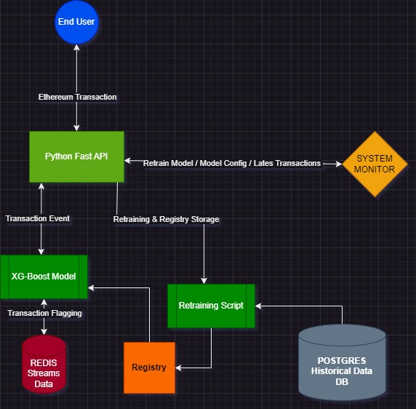
System Design

